Slide 1
Foreside Commons HOA Annual Meeting 6/25/2022 10 AM to 12 Noon Zoom Meeting

Slide 2
Todays Meeting Agenda
Opening remarks -Ken Jones President FCHOA
Welcome New Members- Dean & Sue Clark –All
Welcome Mr. and Mrs. Roe
OV Town Council Member, District 1 - Update on OV Marina Restaurant - Steve Cobb
Proposed FCHOA 2023 Budget- Therese Weise - FCHOA Treasurer
Budget Discuss -All
FCHOA Deed of Restriction Review and Recommendation- Tim Larimore, Vice President/Secretary
Topic Discussion -All
Foreside Commons Kayak Project Update – Bill Kopajtic - Kayak Project Chair
Topic Discussion- All
New Business-All
Adjournment

Slide 3
Welcome to our Community!!
Dean and Sue Clark
&
Mr. and Mrs. Roe

Slide 4
Welcome Stephen Cobb OV Town Council District 1
Brief Update on the proposed expansion OV Marina to add a Restaurant - Steve Cobb

Slide 5
FCHOA Treasurer Report Therese Weise Treasurer
Proposed FCHOA 2023 Budget- Therese Weise - FCHOA Treasurer
Budget Discuss -All

Slide 6
FCHOA Deed of Restriction Review and Recommendation
FCHOA Deed of Restrictions Review and Recommendation- Tim Larimore, Vice President/Secretary
Topic Discussion -All

Slide 7
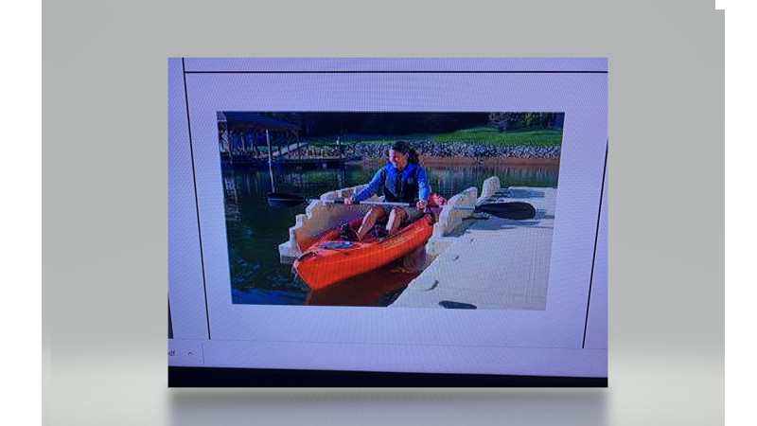
Foreside Commons Kayak Project Update – Bill Kopajtic - Kayak Project Chair

Slide 8
Foreside Commons Community Kayak Project How we got here?

Slide 9
Foreside Commons Home Owners Association Annual Meeting June 26, 2021 Introduction and Discussion of New Kayak ramp and floating Dock-Bill Kopajpic. Bill Kopajpic presented 2 drawings from the EZ Dock company There was strong support from the 7 home owners in attendance for moving forward with the proposal. Ken would send out an email to non meeting attendees to solicit their interest in moving forward with the New Kayak ramp and floating Dock. Bob Whiting was in support of the proposal. Kerry Case expressed support for proposal Tim Larrimore is 100% in support of proposal. Theresa Kopajpic or Muriel Larrimore suggested that we reach out to Grand View Shores to see if any of their homeowners would be willing to collaborate with us to build and fund the new ramp/floating dock. The FCHOA will continue to collect additional information on this project concerning: Cost Community participation Timeline to contract Feasibility

Slide 10
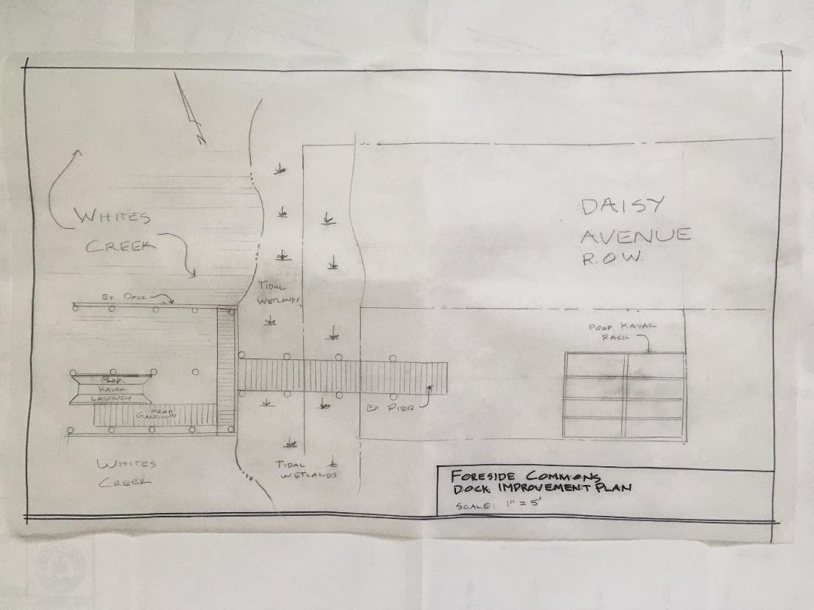
Schematic Plan

Slide 11
Picture of the Kayak Launcher

Slide 12
Here’s where we are today
Request for Permit Submit to DNREC in Nov 2021
We expect to receive our Permit to build our Launcher on the week of 6/27 2022
Develop a Draft agreement Between Foreside Commons (FC)and Grand View Shores (GVS)
Draft Agreement of Accommodation is in review with both communities
GVS has agreed to pay for the cost of the Launcher and installation
FC will provide the FC dock space for the launcher
Draft Rules and regulation are in development
Storage Racks plans are being discussed

Slide 13
Draft Foreside Commons & Grand View Shores Agreement of Accommodation

Slide 14
It is mutually agreed that this agreement is for the exclusive use of the members of the Associations and the term of the agreement shall continue until either association terminates it with 90 days written notice to the other. An initial set Term for this agreement is ?
It is anticipated that a floating kayak launch system can be installed on the common area owned by Foreside Commons and in consideration of that accommodation, Grandview Shores will pay for the equipment and installation based on A Plus Marine revised quote dated 5-16-2022 attached.
Any changes in the agreement shall be made in writing and mutually agreed upon by both Associations.
Grand View Shores Home Owners Association, Inc
Foreside Commons Association of Owners, Inc.

Slide 15
Draft Kayak Rules and Regulations
Draft Kayak/Canoe Dock, Launch and Storage Rack Rules and Regulations
PARKING
-There is to be NO parking at the end of Daisey Avenue. The area can be used to unload kayaks/canoes and equipment only.
-At all times, please respect neighbors of Daisey Ave and DO NOT use their driveways, without their expressed consent, to turn around.
We would encourage all Kayak owners to limit vehicle drop off of their Kayaks to a minimum. Ideally in the beginning of the kayak boating season and pick up at the end of the season.
We recognize that kayak owners may from time to time take their kayak to other locations .
We highly recommend using trans porter dollies to pick up and deliver their Kayak/Canoe to the Dock and/or storage racks
KAYAK/WATERCRAFT STORAGE
-One community storage rack will be provided for each community, on that community’s property. Foreside Commons’ rack will be constructed on its out parcel; Grandview Estates rack will be constructed on its property. Respective communities (Foreside Commons and Grandview Estates) will lease kayak berths to members of their community. Fees and regulations of the racks will be determined by the respective HOAs.
Should there be available racks from either community those rack(s) can be assigned to member(s) for use by both communities based on availability .
-Kayaks/Canoes must be in designated racks and locked or secured when not in use.
-Permits or designation stickers will be given to berth holders. The permit or sticker must be attached to the kayak/canoe and face outward for inspection if necessary.
If a Kayak is abandon for whatever reason the joint communities are authorized to attempt to contact the Kayak owner and if after 30 days the kayak is not removed from the rack the community can dispose of the abandon kayak
RAMP/LAUNCH ETIQUETTE
-Kayaks/Canoes must not be left at ramp/launch unattended;
-Be considerate of those unloading or launching;
-Take trash and belongings with you when you leave the area.
Working together we can enjoy the Kayak launcher enhancement to both Foreside Commons and Grand View Shores communities and waterways surrounding our beautiful location

Slide 16
A detailed and complex kayak/canoe rack

Slide 17
A simple kayak/canoe rack

Slide 18
What’s left to do
Get DNREC Permit
Finalize Agreement of Accommodation between the 2 organizations
Finalize Kayak operation Rules and Regulations
Decide on Kayak RACKS and funding method
Get Ocean View and Sussex County Permits
Contract with A Plus Marine Services and Install floating Ramp
When Launcher arrives install
Have Ribbon cutting and Celebration

Slide 19
Questions? Discussion

Slide 20
Thank You for joining us for the Annual meeting and for your input & attention to these important matters! Happy Summer To All! Don’t Forget to mark your calendar for September 10 2022 For our Joint Annual Picnic This Year Hosted by Grand View Shores Carey & Judy Verger 49 Daisey Avenue
The minutes and this presentation will be available on our web site by Friday July, 1 2022
http://www.foresidecommons.com

